Slide 1
ECEG-5193: Algorithm Analysis and Design
Analysis of Sorting and Searching algorithms
Hash Table

Slide 2
Hashtables
Constant time insertion and search (and deletion in some cases) for a large space of keys
Applications
Does x belong to S?
compilers
databases
search engines
storing and retrieving non-squential data
save memory over an array

Slide 3
Key/data pair
The key is a numeric representation of a relevant portion of the data
For example:
data
key
integer
number

Slide 4
Key/data pair
The key is a numeric representation of the relevant portion of the data
For example:
data
key
ascii code
string
number

Slide 5
Key/data pair
The key is a numeric representation of the relevant portion of the data
For example:
ascii code of first and last name
key
data
account information
number

Slide 6
Why not just arrays aka direct-address tables?
array must be as large as the universe of keys
universe of keys - U
Array

Slide 7
Why not just arrays?
array must be as large as the universe of keys
universe of keys - U
space of actual keys is often much smaller than the actual keys
actual keys, n
Array

Slide 8
Why not arrays?
Not feasible!
Even if it were, not space efficient

Slide 9
The load of a table/hashtable
m = number of possible entries in the table
n = number of keys stored in the table
α = n/m is the load factor of the hashtable
The smaller α, the more wasteful the table
The load also helps us talk about run time

Slide 10
Hash function, h
A hash function is a function that maps the universe of keys to the slots in the hashtable
universe of keys - U
hash function, h
m << |U|

Slide 11
Hash function, h
A hash function is a function that maps the universe of keys to the slots in the hashtable
universe of keys - U
hash function, h
m << |U|

Slide 12
Hash function, h
A hash function is a function that maps the universe of keys to the slots in the hashtable
universe of keys - U
hash function, h
m << |U|

Slide 13
Hash function, h
What can happen if m ≠ |U|?
universe of keys - U
hash function, h
m << |U|

Slide 14
Collisions
If m ≠ |U|, then two keys can map to the same position in the hashtable
universe of keys - U
hash function, h
m << |U|

Slide 15
Collisions
A collision occurs when h(x) = h(y), but x ≠ y
A good hash function will minimize the number of collisions
Because the number of hashtable entries is less than the possible keys (i.e. m < |U|) collisions are inevitable!

Slide 16
Collision resolution by chaining
Hashtable consists of an array of linked lists
When a collision occurs, the element is added to linked list at that location
If two entries x ≠ y have the same hash value h(x) = h(x), then T(h(x)) will contain a linked list with both values

Slide 17

Insertion
ChainedHashInsert( )

Slide 18
Insertion
h( )
hash function is a mapping from the key to some value < m

Slide 19
Insertion
h( )

Slide 20

Deletion
pass in a pointer not the value

Slide 21
Deletion

Slide 22
Deletion

Slide 23

Search
ChainedHashSearch( )

Slide 24
Search
h( )

Slide 25
Search
ChainedHashSearch( )

Slide 26
Search
ChainedHashSearch( )

Slide 27
Search
ChainedHashSearch( )

Slide 28
Running time
Θ(1)
Depends on ChainedHashSearch
O(length of the chain)

Slide 29
Length of the linked lists
Worst case?

Slide 30
Length of the chain
Worst case?
All elements hash to the same location
h(k) = 4
O(n)
…

Slide 31
Length of the chain
Average case
Depends on how well the hash function distributes the keys
Assume simple uniform hashing: an element is equally likely to end up in any of the m slots
Under simple uniform hashing what is the average length of a chain in the table?
n keys over m slots = n / m = α

Slide 32
Average chain length
If you roll a fair m sided die n times, how many times are we likely to see a given value?
For example, 10 sided die:
1 time
1/10
100 times
100/10 = 10

Slide 33
Search average running time
Two cases:
Key is not in the table
must search all entries
Θ(1 + α)
Key is in the table
on average search half of the entries
O(1 + α)

Slide 34
Analysis of Search in Hash Tables
If m (# of slots) is proportional to n (# of elements in the table):
n = O(m)
α = n/m = O(m)/m = O(1)
⇒ Searching takes constant time on average

Slide 35
Hash functions
What makes a good hash function?
Approximates the assumption of simple uniform hashing
Deterministic – h(x) should always return the same value
Low cost – if it is expensive to calculate the hash value (e.g. log n) then we don’t gain anything by using a table
Challenge: we don’t generally know the distribution of the keys
Frequently data tend to be clustered (e.g. similar strings, run-times, SSNs). A good hash function should spread these out across the table

Slide 36
Division method
h(k) = k mod m
M K h(k)
11 25
3
11 1
1
11 17
6
13 133
3
13 7
7
13 25
12

Slide 37
Division method
Don’t use a power of two. Why?
if h(k) = k mod 2^{p}, the hash function is just the lower p bits of the value
m k bin(k) h(k)
25 11001 1
8 1 00001 1
8 17 10001 1

Slide 38
Division method
Good rule of thumb for m is a prime number not to close to a power of 2
Pros:
quick to calculate
easy to understand
Cons:
keys close to each other will end up close in the hashtable

Slide 39
Multiplication method
Multiply the key by a constant 0 < A < 1 and extract the fractional part of kA, then scale by m to get the index
extracts the fractional portion of kA

Slide 40
Multiplication method
Common choice is for m as a power of 2 and
Why a power of 2?
Book has other heuristics

Slide 41
Multiplication method
m k A
8 15 0.618
8 23 0.618
8 100 0.618
kA h(k)
9.27
floor(0.27*8) = 2
14.214
floor(0.214*8) = 1
61.8
floor(0.8*8) = 6

Slide 42
Other hash functions
cyclic redundancy checks (i.e. disks, cds, dvds)
Checksums (i.e. networking, file transfers)
Cryptographic (i.e. MD5, SHA)

Slide 43
Open addressing
Keeping around an array of linked lists can be inefficient and a hassle
Like to keep the hashtable as just an array of elements (no pointers)
How do we deal with collisions?
compute another slot in the hashtable to examine

Slide 44
Hash functions with open addressing
Hash function must define a probe sequence which is the list of slots to examine when searching or inserting
Hash function takes an additional parameter i which is the number of collisions that have already occurred
The probe sequence must be a permutation of every hashtable entry. Why?
{ h(k,0), h(k,1), h(k,2), …, h(k, m-1) } is a permutation of { 0, 1, 2, 3, …, m-1 }

Slide 45
Probe sequence
h(k, 0)

Slide 46
Probe sequence
h(k, 1)

Slide 47
Probe sequence
h(k, 2)

Slide 48
Probe sequence
h(k, 3)

Slide 49
Probe sequence
h(k, …)
must visit all locations
…

Slide 50
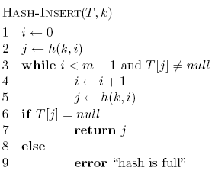
Open addressing: Insert

Slide 51
Open addressing: Insert
get the first hashtable entry to look in

Slide 52
Open addressing: Insert
follow the probe sequence until we find an open entry

Slide 53
Open addressing: Insert
return the open entry

Slide 54
Open addressing: Insert
hashtable can fill up

Slide 55
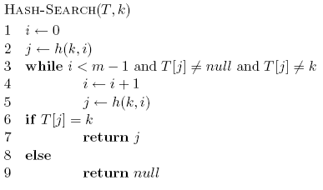
Open addressing: search

Slide 56
Open addressing: search

Slide 57
Open addressing: delete
What happens if we simple delete a node?
“breaks” the probe sequence

Slide 58
Open addressing: delete
Two options:
mark node as “deleted” (rather than null)
modify search procedure to continue looking if a “deleted” node is seen
modify insert procedure to fill in “deleted” entries
increases search times
if a lot of deleting will happen, use chaining

Slide 59
Probing schemes
Linear probing
– if a collision occurs, go to the next slot
h(k, i) = (h(k) + i) mod m
Does it meet our requirement that it visits every slot?
for example, m = 7 and h(k) = 4
h(k,0) = 4
h(k,1) = 5
h(k,2) = 6
h(k,3) = 0
h(k,3) = 1

Slide 60
Linear probing: search
h( , 0)

Slide 61
Linear probing: search
h( , 1)

Slide 62
Linear probing: search
h( , 2)

Slide 63
Linear probing: search
h( , 3)

Slide 64
Linear probing: search
h( , 3)

Slide 65
Linear probing: Deleting a key
Problems
Cannot mark the slot as empty
Impossible to retrieve keys inserted after that slot was occupied
Solution
Mark the slot with a sentinel value DELETED
The deleted slot can later be used for insertion
Searching will be able to find all the keys
0
m - 1

Slide 66
Linear probing
Problem:
primary clustering – long rungs of occupied slots tend to build up and these tend to grow
any value here results in an increase in the cluster
become more and more probable for a value to end up in that range

Slide 67
Quadratic probing
h(k, i) = (h(k) + c₁i + c₂i²) mod m
Rather than a linear sequence, we probe based on a quadratic function
Problems:
must be constants and m so that we have a proper probe sequence
if h(x) = h(y), then h(x, i) = h(y, i) for all i
secondary clustering

Slide 68
Double Hashing
(1) Use one hash function to determine the first slot
(2) Use a second hash function to determine the increment for the probe sequence
h(k,i) = (h₁(k) + i h₂(k) ) mod m, i=0,1,...
Initial probe: h₁(k)
Second probe is offset by h₂(k) mod m, so on ...

Slide 69
Double Hashing: Example
h₁(k) = k mod 13
h₂(k) = 1+ (k mod 11)
h(k,i) = (h₁(k) + i h₂(k) ) mod 13
Insert key 14:
h₁(14,0) = 14 mod 13 = 1
h(14,1) = (h₁(14) + h₂(14)) mod 13
= (1 + 4) mod 13 = 5
h(14,2) = (h₁(14) + 2 h₂(14)) mod 13
= (1 + 8) mod 13 = 9
0
79
69
98
72
50
1
2
3
4
5
6
7
8
9
14
10
11
12

Slide 70
Double Hashing
Probe sequence is determined by a second hash function
h(k, i) = (h₁(k) + i(h₂(k)) mod m
Advantage: avoids clustering
Disadvantage:
harder to delete an element
h₂(k) must visit all possible positions in the table
Can generate m² probe sequences maximum

Slide 71
Running time of insert and search for open addressing
Depends on the hash function/probe sequence
Worst case?
O(n) – probe sequence visits every full entry first before finding an empty

Slide 72
Running time of insert and search for open addressing
Average case?
We have to make at least one probe

Slide 73
Running time of insert and search for open addressing
Average case?
What is the probability that the first probe will not be successful?
α

Slide 74
Running time of insert and search for open addressing
Average case?
What is the probability that the first two probed slots will not be successful?
~α²
why ‘~’?

Slide 75
Running time of insert and search for open addressing
Average case?
What is the probability that the first three probed slots will not be successful?
~α³

Slide 76
Running time of insert and search for open addressing
Average case: expected number of probes
sum of the probability of making 1 probe, 2 probes, 3 probes, …

Slide 77
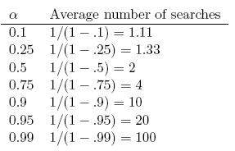
Average number of probes

Slide 78
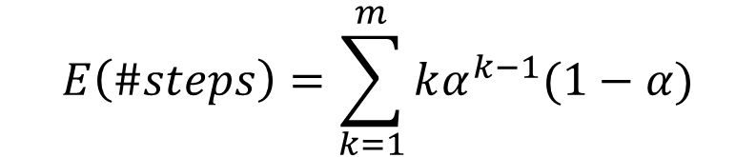


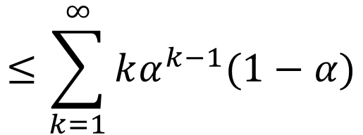
Analysis of Open Addressing
Ignore the problem of clustering and assume that all probe sequences are equally likely
Unsuccessful retrieval:
$$E\left(\#steps\right)=\sum_{k=1}^{m}{kα^{k−1}(1−α)}$$
Probability(prob hits an occupied cell):
α
Probability(prob hits an empty cell):
1 - α
$$≤\sum_{k=1}^{∞}{kα^{k−1}(1−α)}$$
Probability that a prob terminates in 2 steps:
α (1 - α)
Probability that a prob terminates in k steps:
α ^{k-1} (1 - α)
$$=(1−α)\frac{1}{{(1−α)}^{2}}$$
What is the average number of steps in a probe?
$$=\frac{1}{1−α}$$

Slide 79


Analysis of Open Addressing
Unsuccessful retrieval:
$$E\left(\#steps\right)=\frac{1}{1−α}$$
Successful retrieval:
$E\left(\#steps\right)=\frac{1}{α}$ $\ln{(\frac{1}{1−α})}$
Unsuccessful retrieval:
a=0.5 E(#steps) = 2
a=0.9 E(#steps) = 10
Successful retrieval:
a=0.5 E(#steps) = 3.387
a=0.9 E(#steps) = 3.670

Slide 80
How big should a hashtable be?
A good rule of thumb is the hashtable should be around half full
What happens when the hashtable gets full?
Copy: Create a new table and copy the values over
results in one expensive insert
simple to implement
Amortized copy: When a certain ratio is hit, grow the table, but copy the entries over a few at a time with every insert
no single insert is expensive and can guarantee per insert performance
more complicated to implement

Slide 81
Hash Functions
A hash function transforms a key into a table address
What makes a good hash function?
(1) Easy to compute
(2) Approximates a random function: for every input, every output is equally likely (simple uniform hashing)
In practice, it is very hard to satisfy the simple uniform hashing property
i.e., we don’t know in advance the probability distribution that keys are drawn from

Slide 82
Good Approaches for Hash Functions
Minimize the chance that closely related keys hash to the same slot
Strings such as pt and pts should hash to different slots
Derive a hash value that is independent from any patterns that may exist in the distribution of the keys

Slide 83
The Division Method
Idea:
Map a key k into one of the m slots by taking the remainder of k divided by m
h(k) = k mod m
Advantage:
fast, requires only one operation
Disadvantage:
Certain values of m are bad, e.g.,
power of 2
non-prime numbers

Slide 84
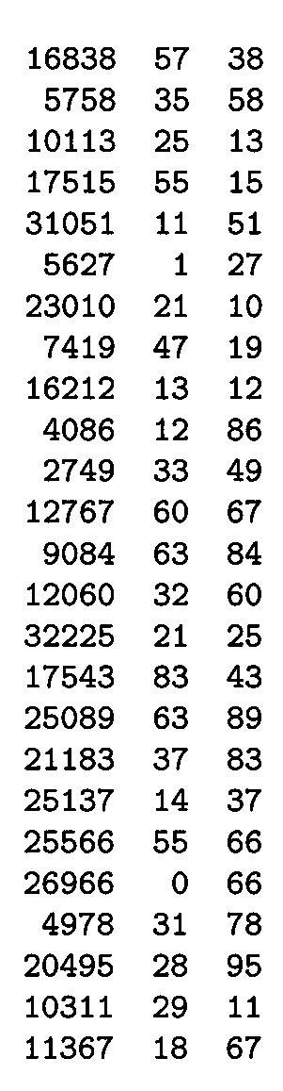
Example - The Division Method
m97
m
100
If m = 2^{p}, then h(k) is just the least significant p bits of k
p = 1 ⇒ m = 2
⇒ h(k) = , least significant 1 bit of k
p = 2 ⇒ m = 4
⇒ h(k) = , least significant 2 bits of k
Choose m to be a prime, not close to a
power of 2
Column 2:
Column 3:
{0, 1}
{0, 1, 2, 3}
k mod 97
k mod 100

Slide 85

The Multiplication Method
Idea:
Multiply key k by a constant A, where 0 < A < 1
Extract the fractional part of kA
Multiply the fractional part by m
Take the floor of the result
h(k) = = ⎣m (k A mod 1)⎦
Disadvantage: Slower than division method
Advantage: Value of m is not critical, e.g., typically 2^{p}
fractional part of kA = kA - ⎣kA⎦

Slide 86
Example – Multiplication Method

Slide 87
Universal Hashing
In practice, keys are not randomly distributed
Any fixed hash function might yield Θ(n) time
Goal: hash functions that produce random table indices irrespective of the keys
Idea:
Select a hash function at random, from a designed class of functions at the beginning of the execution

Slide 88
Universal Hashing
(at the beginning
of the execution)

Slide 89
Definition of Universal Hash Functions
H={h(k): U → (0, 1 ,…, m-1)}

Slide 90
How is this property useful?
Pr(h(x)=h(y))=

Slide 91
Universal Hashing – Main Result
With universal hashing the chance of collision between distinct keys k and l is no more than the 1/m chance of collision if locations h(k) and h(l) were randomly and independently chosen from the set {0, 1, …, m – 1}

Slide 92
Designing a Universal Class of Hash Functions
Choose a prime number p large enough so that every possible key k is in the range [0 ... p – 1]
Z_{p} = {0, 1, …, p - 1} and Z_{p}* = {1, …, p - 1}
Define the following hash function
h_{a,b}(k) = ((ak + b) mod p) mod m,
∀ a ∈ Z_{p}* and b ∈ Z_{p}
The family of all such hash functions is
H_{p,m} = {h_{a,b}: a ∈ Z_{p}* and b ∈ Z_{p}}
a , b: chosen randomly at the beginning of execution
The class H_{p,m} of hash
functions is universal

Slide 93
Example: Universal Hash Functions
E.g.: p = 17, m = 6
h_{a,b}(k) = ((ak + b) mod p) mod m
h_{3,4}(8) = ((3⋅8 + 4) mod 17) mod 6
= (28 mod 17) mod 6
= 11 mod 6
= 5

Slide 94
Advantages of Universal Hashing
Universal hashing provides good results on average, independently of the keys to be stored
Guarantees that no input will always elicit the worst-case behavior
Poor performance occurs only when the random choice returns an inefficient hash function – this has small probability

Slide 95
Open Addressing
If we have enough contiguous memory to store all the keys (m > N) ⇒ store the keys in the table itself
No need to use linked lists anymore
Basic idea:
Insertion: if a slot is full, try another one,
until you find an empty one
Search: follow the same sequence of probes
Deletion: more difficult ... (we’ll see why)
Search time depends on the length of the
probe sequence!
e.g., insert 14

Slide 96
Generalize hash function notation:
A hash function contains two arguments now:
(i) Key value, and (ii) Probe number
h(k,p), p=0,1,...,m-1
Probe sequences
<h(k,0), h(k,1), ..., h(k,m-1)>
Must be a permutation of <0,1,...,m-1>
There are m! possible permutations
Good hash functions should be able to
produce all m! probe sequences
insert 14
Example
<1, 5, 9>

Slide 97
SECURE HASHING ALGORITHM

Slide 98
Purpose: Authentication Not Encryption
Authentication Requirements:
Masquerade – Insertion of message from fraudulent source
Content Modification – Changing content of message
Sequence Modification – Insertion, deletion and reordering sequence
Timing Modification – Replaying valid sessions
Notes:
Verify that received messages come from the alleged source and have not been altered. Also verify the sequence and timing. Digital Signature is used to combat denial of receipt of a message by either the source or desitination.

Slide 99
Background Theory
Message Digest or “Fingerprint”
→ Condensed Representation
→ Easy to generate for a given file.
Computationally infeasible to produce two messages with same message digest
Impossible to recreate a message given a message digest.
Data Integrity and Comparison Checking
→ Message Integrity Validation

Slide 100
Applications: One-way hash functions
Public Key Algorithms
Password Logins
Encryption Key Management
Digital Signatures
Integrity Checking
Virus and Malware Scanning
Authentication
Secure Web Connections
(PGP, SSL, SSH, S/MIME)

Slide 101
Variants
MD4 and MD5 by Ron Rivest (1990,1994)
SHA-0, SHA-1 by NSA (1993, 1995)
RIPEMD-160 (1996)
SHA-2 (2002 – 224, 256, 385, 512)
Whirlpool
Tiger
GOST-3411
SHA-3
Winner selected from solicitations in 2012
Notes:
All variants have a similar framework. The variation is in the bits compressed into the digest. Thereby, differ in the number of blocks and words of data used in hashing.

Slide 102
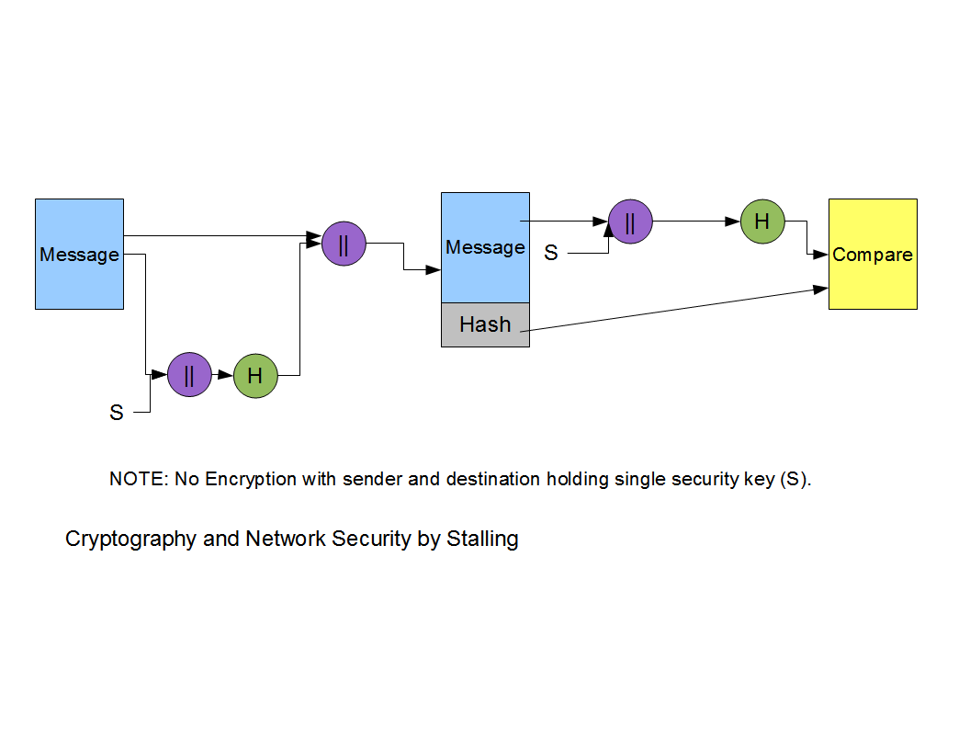
Basic Hash Function Diagram

Slide 103
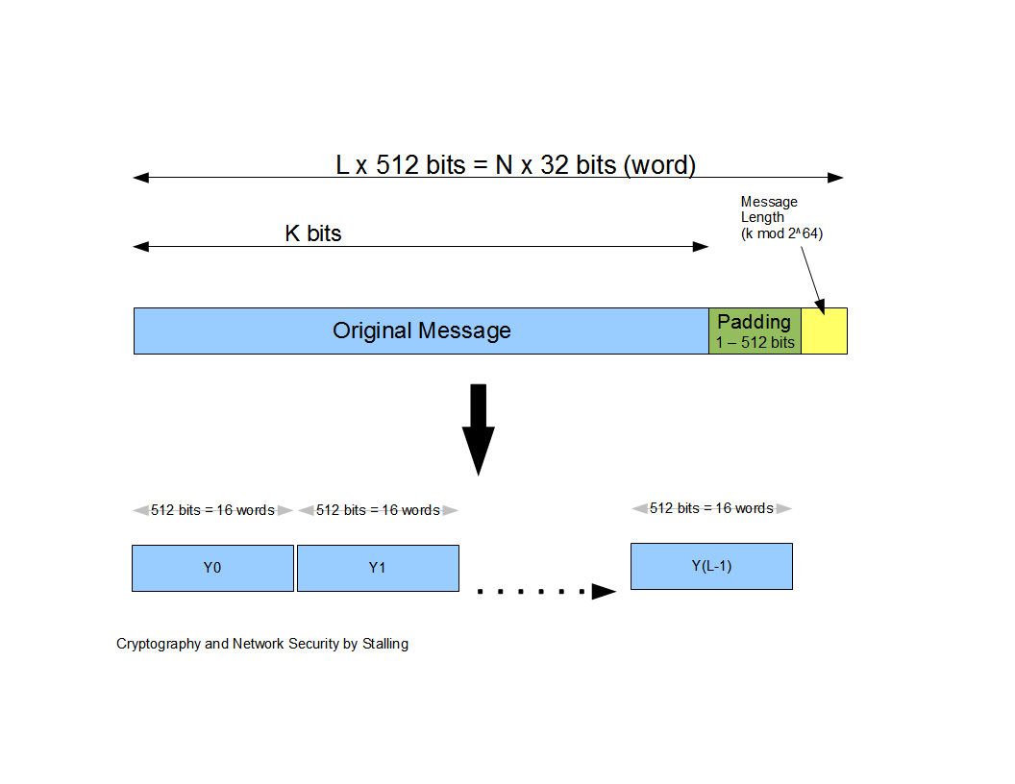
Message Diagram

Slide 104
SHA-1 (160 bit message) Algorithm Framework
Step 1: Append Padding Bits….
Message is “padded” with a 1 and as many 0’s as necessary to bring the message length to 64 bits fewer than an even multiple of 512.
Step 2: Append Length....
64 bits are appended to the end of the padded message. These bits hold the binary format of 64 bits indicating the length of the original message.
http://www.herongyang.com
f

Slide 105
SHA-1 Framework Continued
Step 3: Prepare Processing Functions….
SHA1 requires 80 processing functions defined as:
f(t;B,C,D) = (B AND C) OR ((NOT B) AND D) ( 0 <= t <= 19)
f(t;B,C,D) = B XOR C XOR D (20 <= t <= 39)
f(t;B,C,D) = (B AND C) OR (B AND D) OR (C AND D) (40 <= t <=59)
f(t;B,C,D) = B XOR C XOR D (60 <= t <= 79)
Step 4: Prepare Processing Constants....
SHA1 requires 80 processing constant words defined as:
K(t) = 0x5A827999 ( 0 <= t <= 19)
K(t) = 0x6ED9EBA1 (20 <= t <= 39)
K(t) = 0x8F1BBCDC (40 <= t <= 59)
K(t) = 0xCA62C1D6 (60 <= t <= 79)
http://www.herongyang.com

Slide 106
SHA-1 Framework Continued
Step 5: Initialize Buffers….
SHA1 requires 160 bits or 5 buffers of words (32 bits):
H0 = 0x67452301
H1 = 0xEFCDAB89
H2 = 0x98BADCFE
H3 = 0x10325476
H4 = 0xC3D2E1F0
http://www.herongyang.com

Slide 107
SHA-1 Framework Final Step
Step 6: Processing Message in 512-bit blocks (L blocks in total message)….
This is the main task of SHA1 algorithm which loops through the padded and appended message in 512-bit blocks.
Input and predefined functions:
M[1, 2, ..., L]: Blocks of the padded and appended message f(0;B,C,D), f(1,B,C,D), ..., f(79,B,C,D): 80 Processing Functions K(0), K(1), ..., K(79): 80 Processing Constant Words
H0, H1, H2, H3, H4, H5: 5 Word buffers with initial values
http://www.herongyang.com

Slide 108
SHA-1 Framework Continued
Step 6: Pseudo Code….
For loop on k = 1 to L
(W(0),W(1),...,W(15)) = M[k] /* Divide M[k] into 16 words */
For t = 16 to 79 do:
W(t) = (W(t-3) XOR W(t-8) XOR W(t-14) XOR W(t-16)) <<< 1
A = H0, B = H1, C = H2, D = H3, E = H4
For t = 0 to 79 do:
TEMP = A<<<5 + f(t;B,C,D) + E + W(t) + K(t) E = D, D = C,
C = B<<<30, B = A, A = TEMP
End of for loop
H0 = H0 + A, H1 = H1 + B, H2 = H2 + C, H3 = H3 + D, H4 = H4 + E
End of for loop
Output:
H0, H1, H2, H3, H4, H5: Word buffers with final message digest
http://www.herongyang.com

Slide 109
Message Diagram

Slide 110
SHA-1 Message Digest
The message digest of the string:
“This is a test for theory of computation”
4480afca4407400b035d9debeb88bfc402db514f

Slide 111
Cryptanalysis and Limitation
Key Premises for Hash Functions:
1. Impossible to re-create a message given a fingerprint
2. Collision Free
SHA-1 failure using brute force attack in 2⁸⁰ operations
Collision failure found in 2005 in 2³³ operations

